Slide 1

General Meeting 12.01.2023

Slide 2

Status
File structures
ML Architectures
TNW Data treatment
Writing

Slide 3
DATa issues
Depth correlation
Reflectivity of the TNW traces do not match up with the seismic
Vertical «noise» in acoustic impedance data
Anomalous high values
Known to make predictions worse

Slide 4
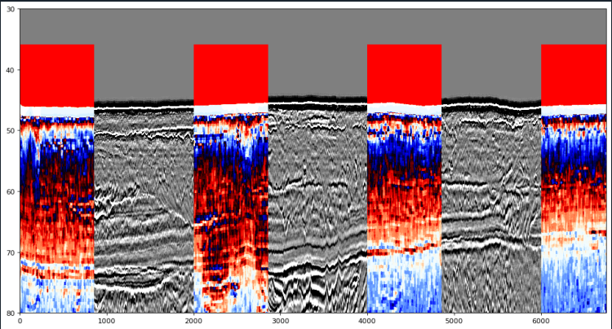
Vertical noise

Slide 5
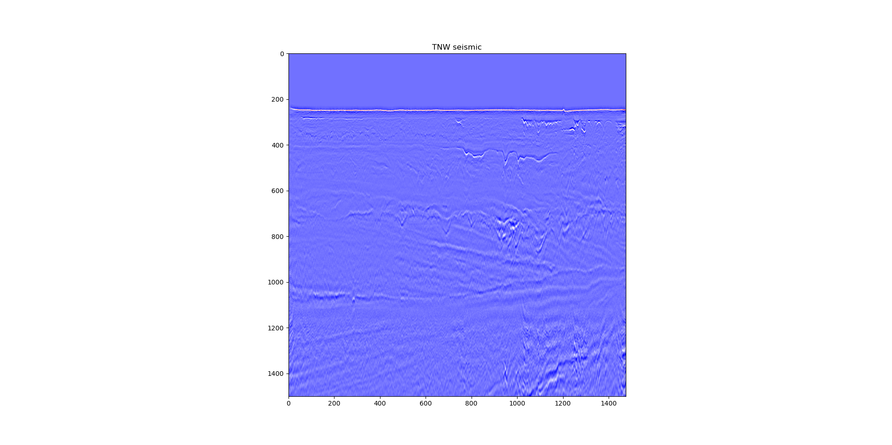

Slide 6
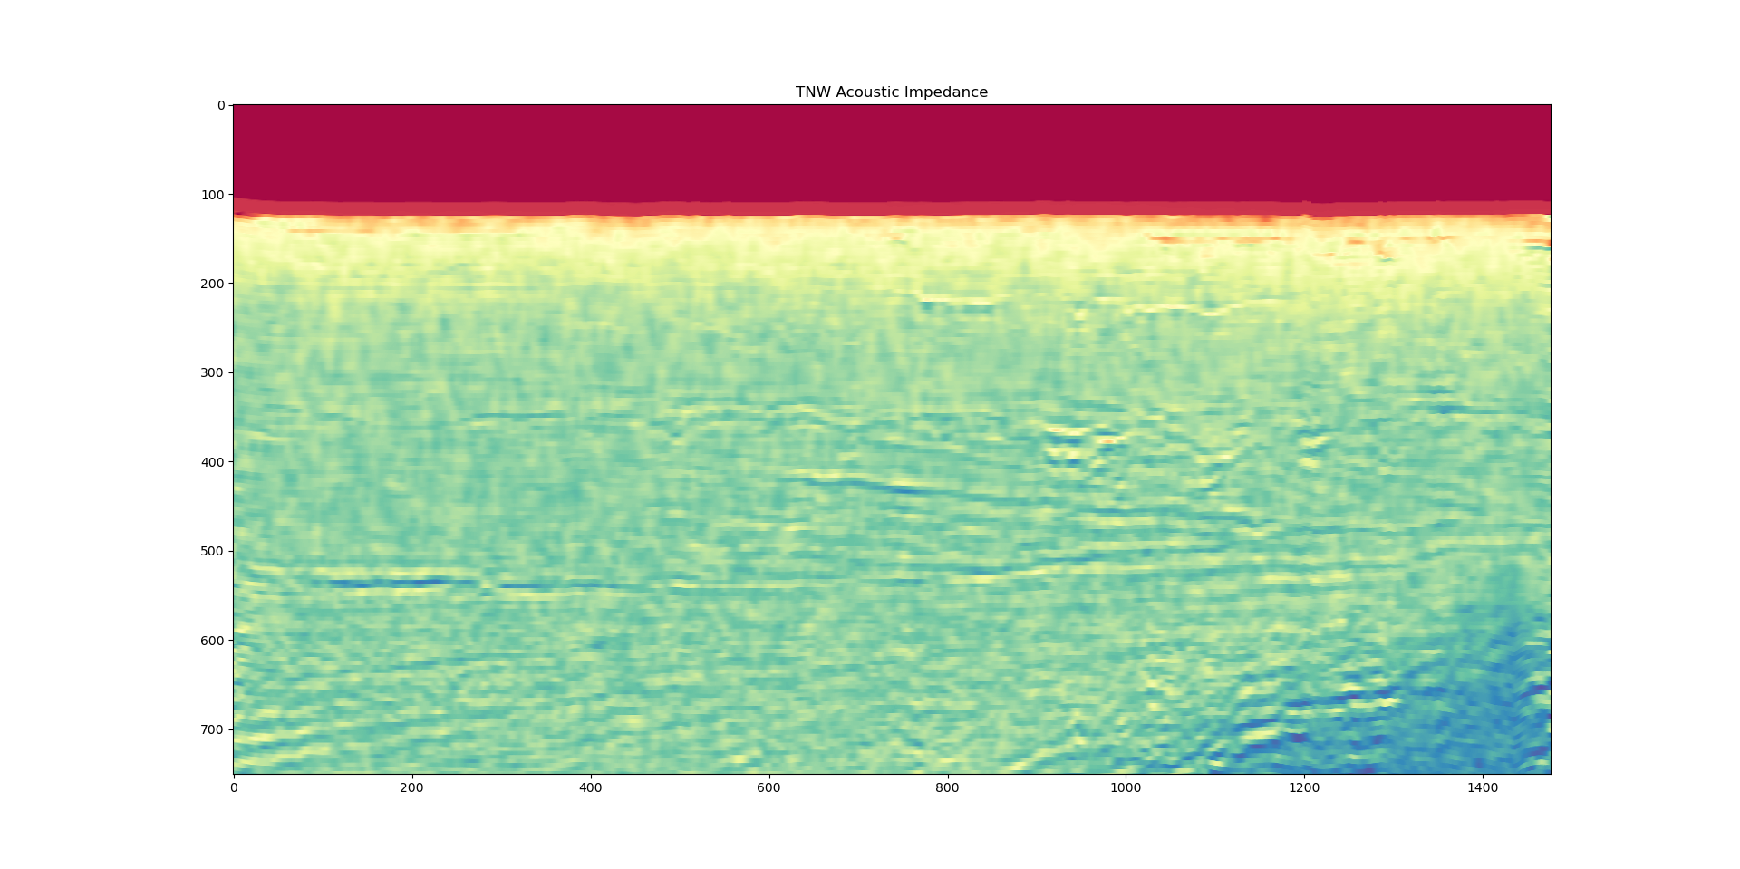

Slide 7
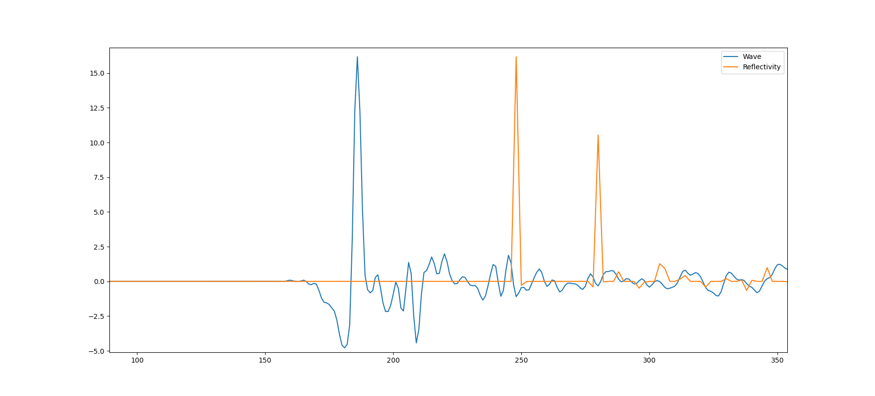
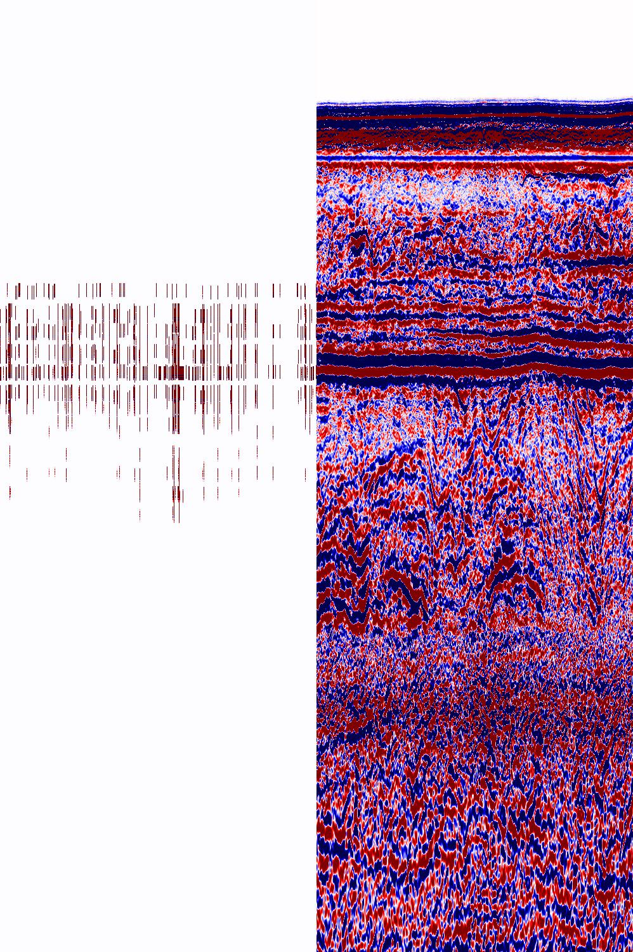
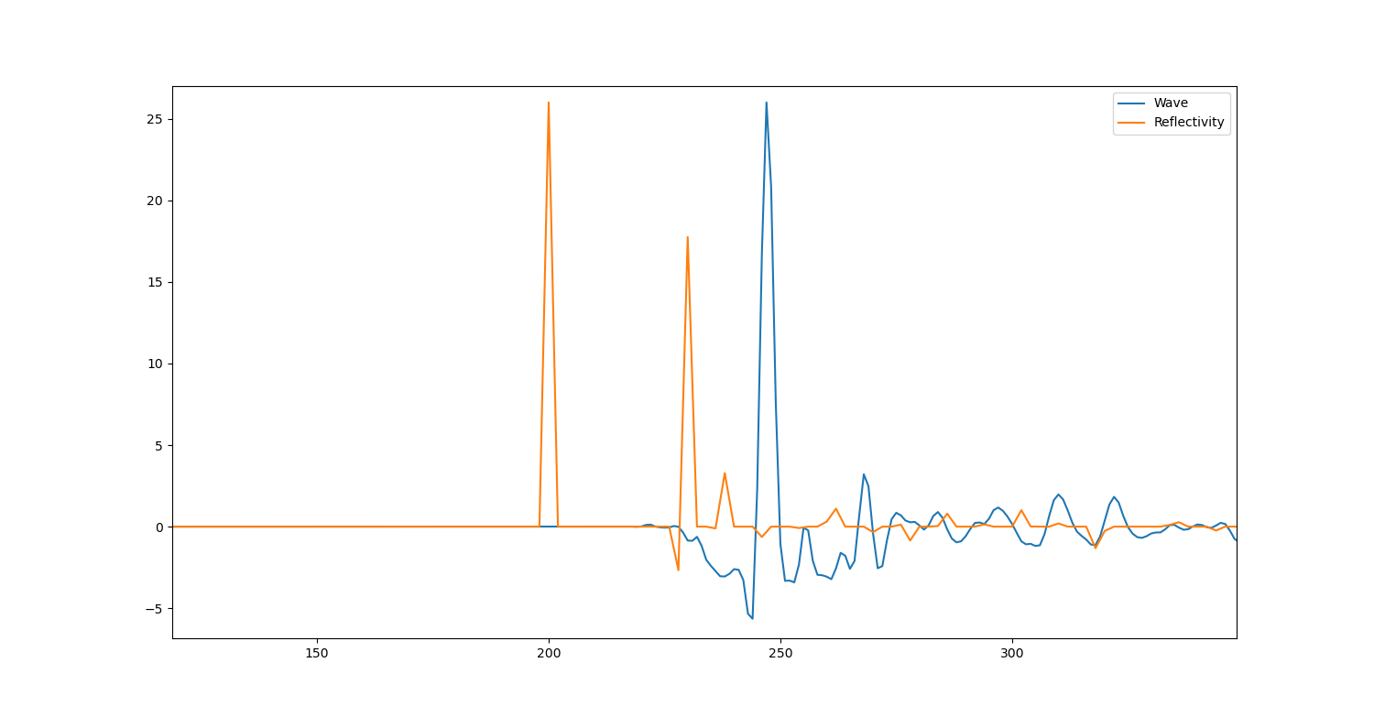
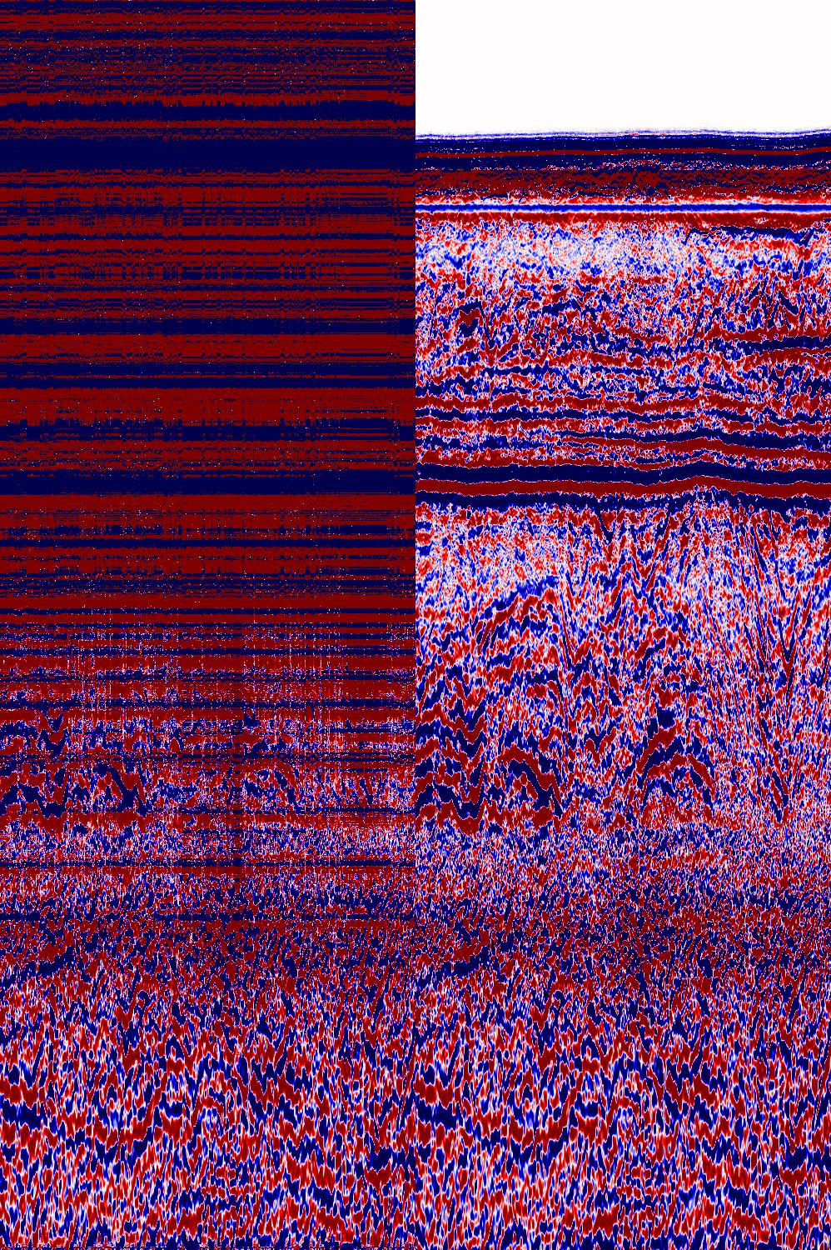
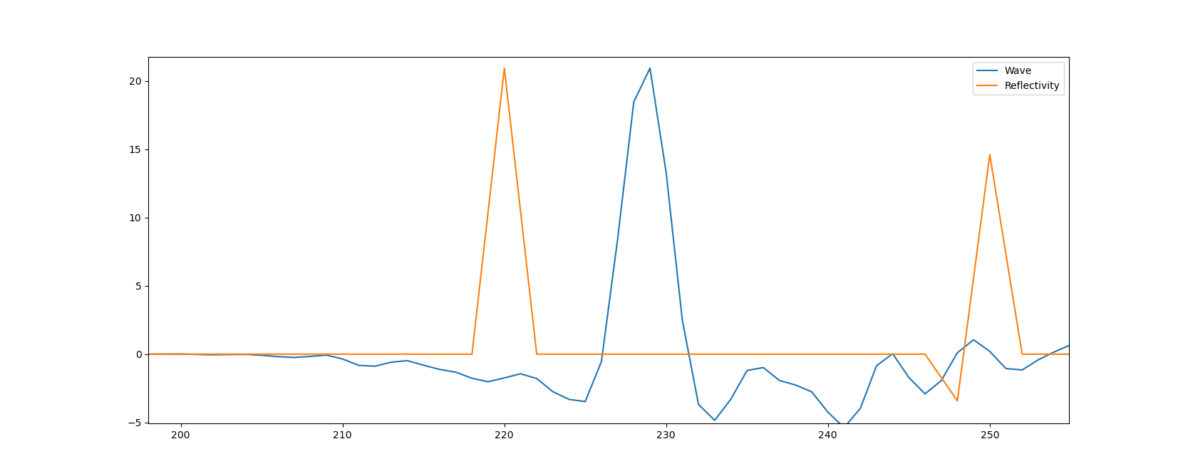
Reflectivity generally matches badly with the traces in the TNW dataset
AGL/3
AGK/0

Slide 8
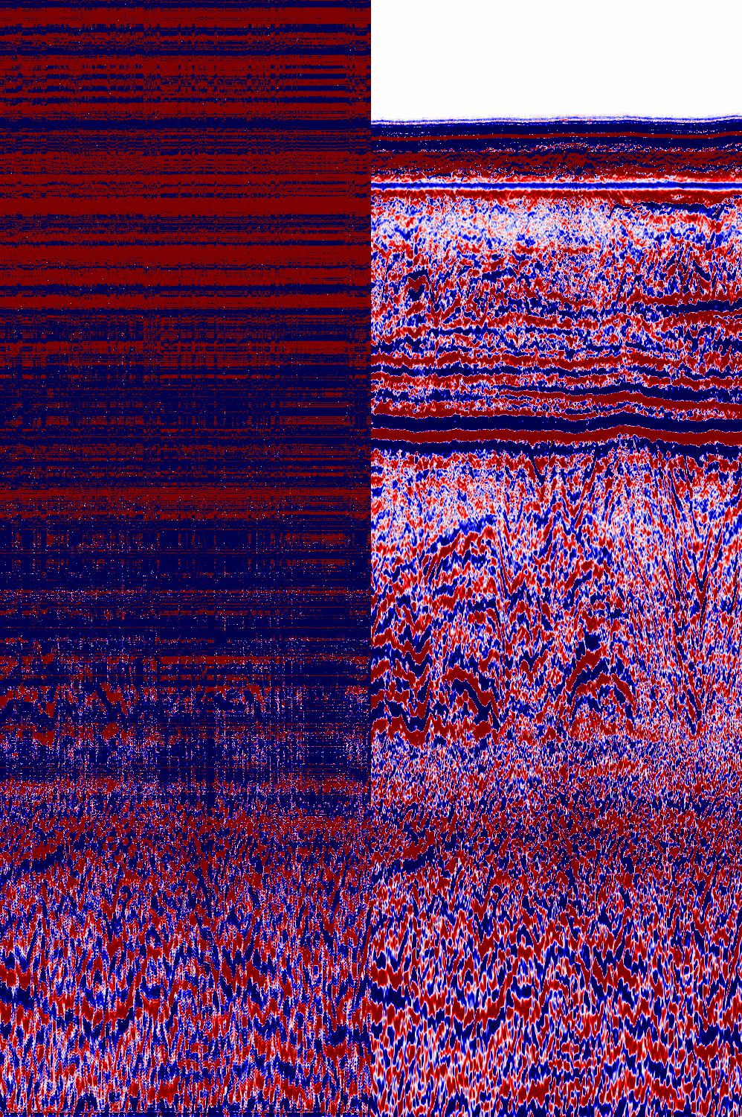
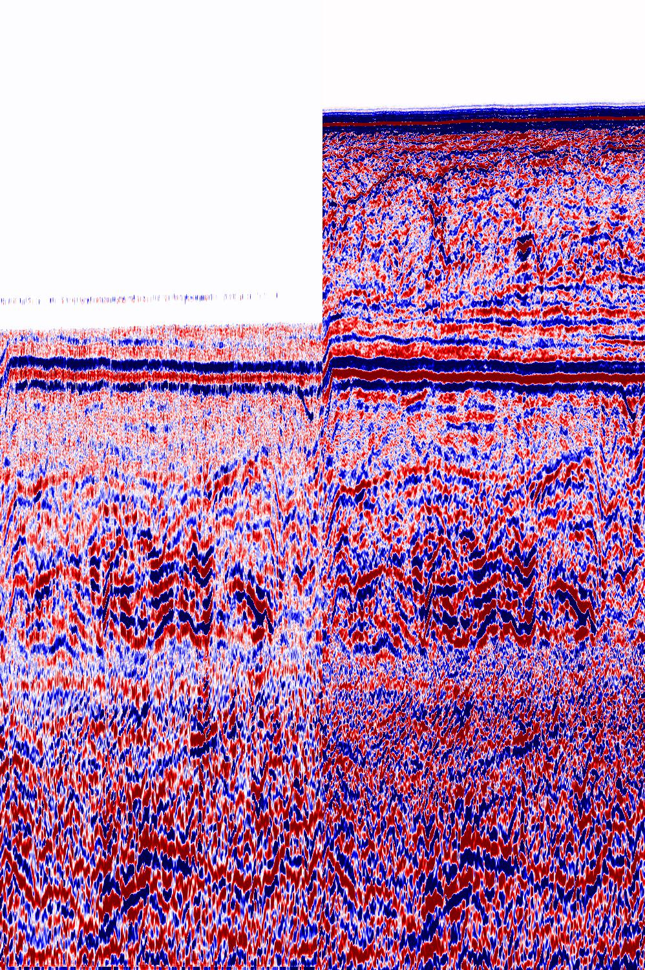
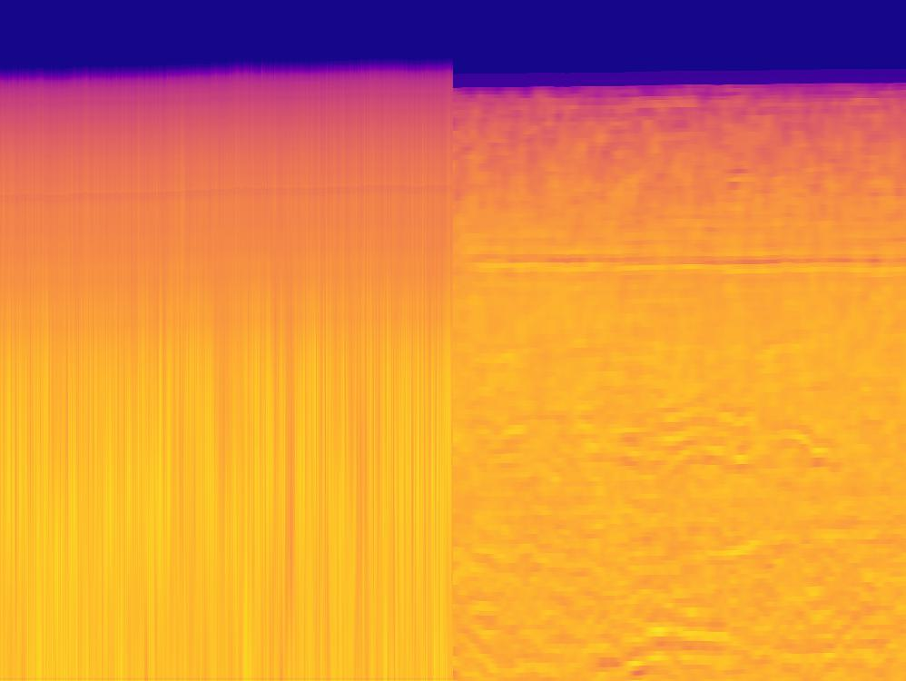
AGH/1
AFA/0

Slide 9
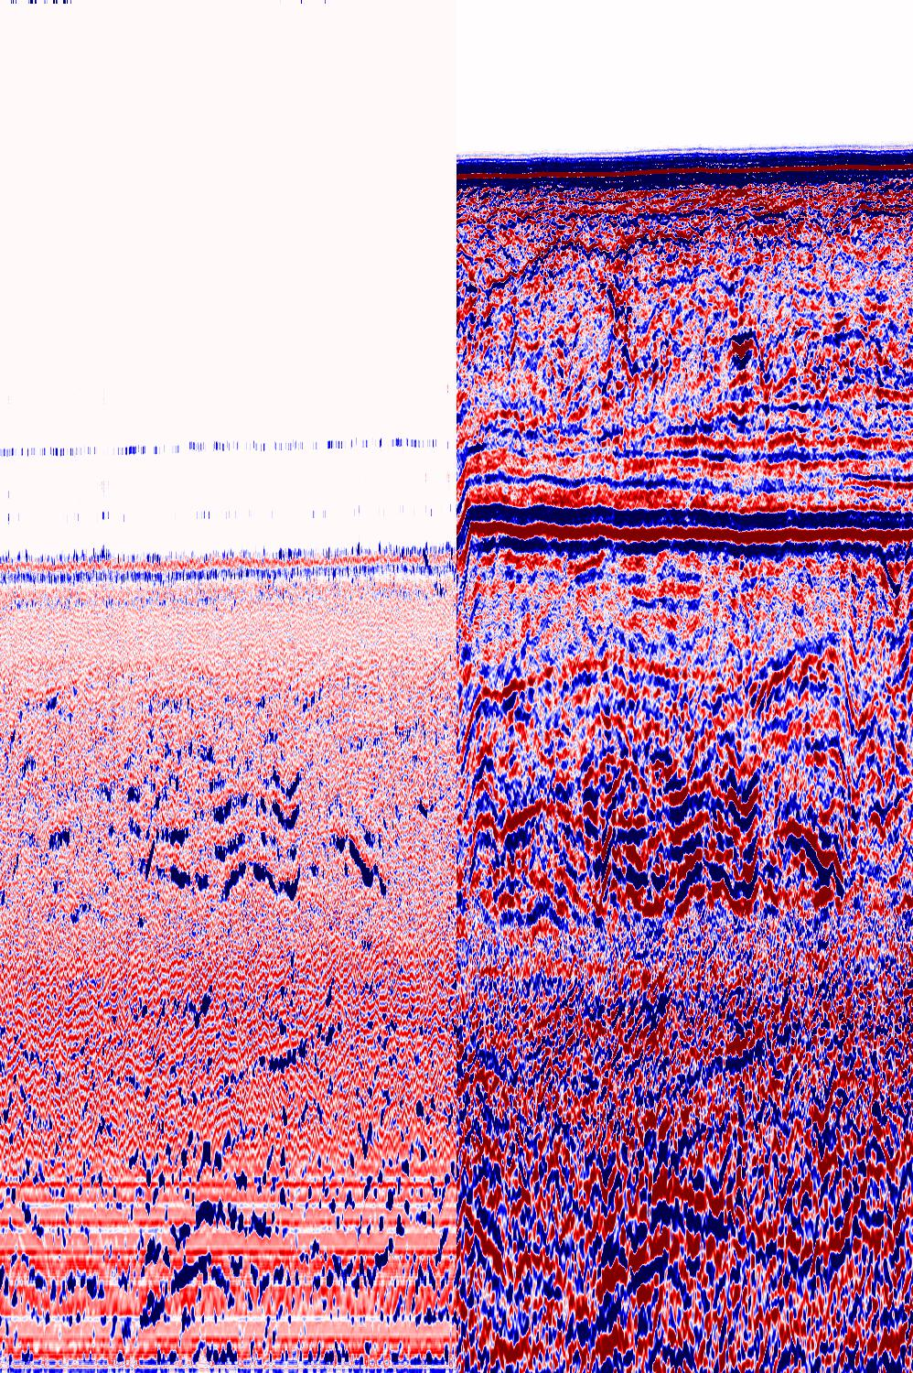
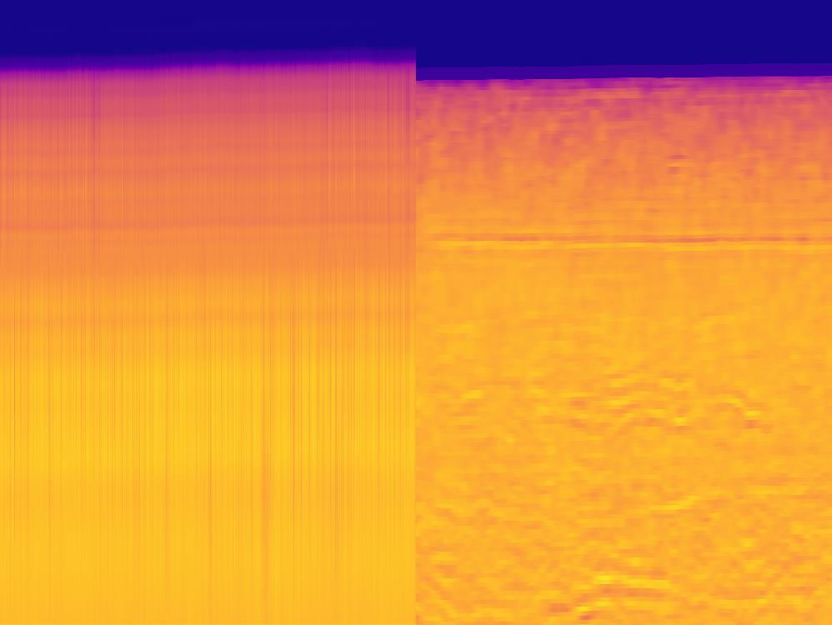
AFA/6

Slide 10
Evaluation thus far on TNW
It seems like the multi-task learning is not particularly helping on the AI inversion, but rather the algorithm focuses more on reconstructing the seismic. I think this is easier for it because of the skip connections
There should be done more data cleaning, and careful selection of the GT dataset
The algorithm generally performs worse when the dataset is bigger, which also indicates that there may be a lot of bad data in the dataset
I should plot the AI using another colormap, for easier diffrentiation

Slide 11
Open source datasets
SEAM dataset
Used for modeling salt body petroleum reservoirs
Will have to model the seismic..
Just convolve the wavelet?
More sophisticated modeling?
Reverse time migration (used by Mustafa)

Slide 12
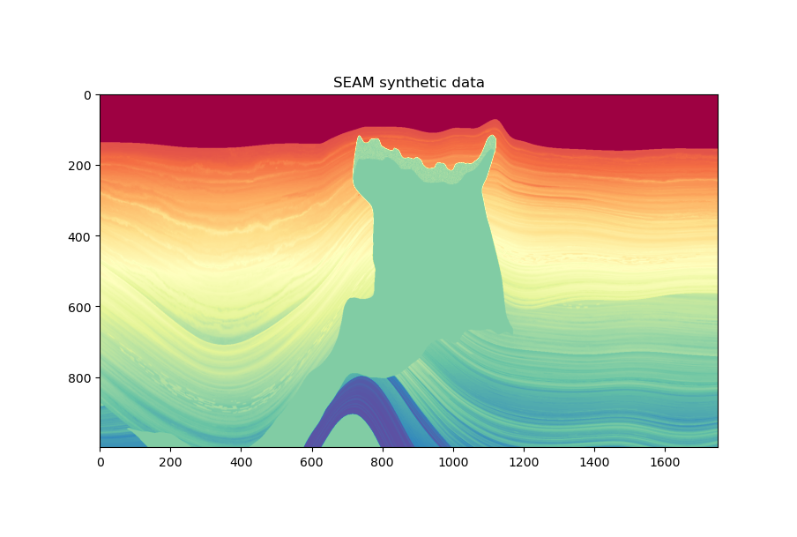

Slide 13
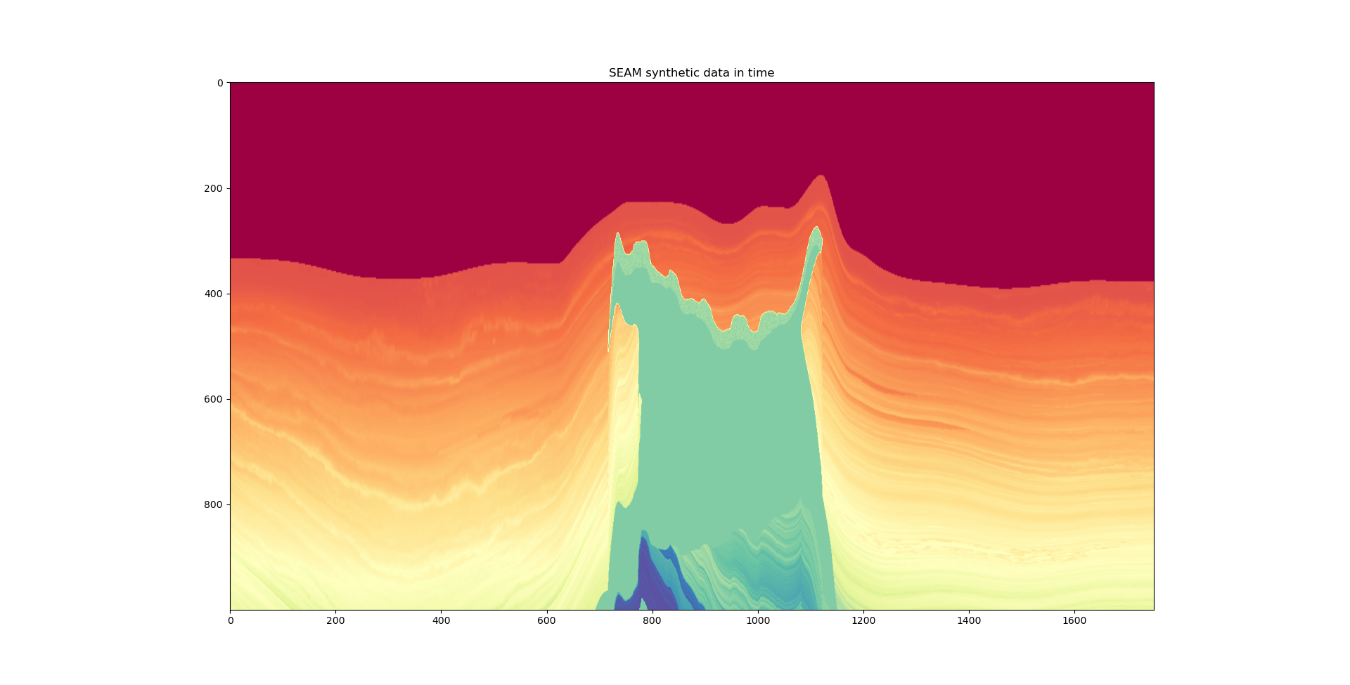

Slide 14
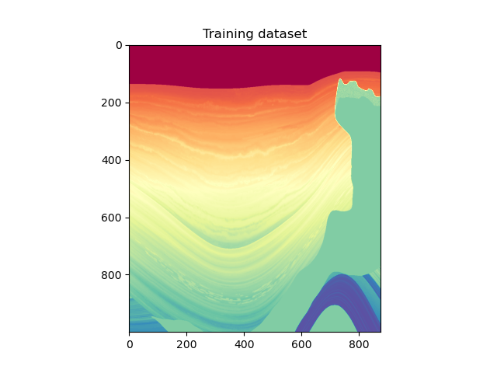
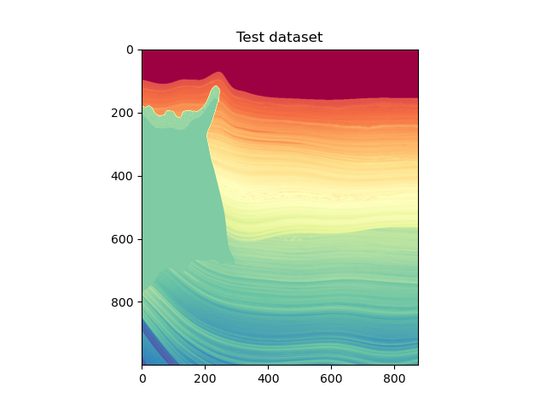

Slide 15
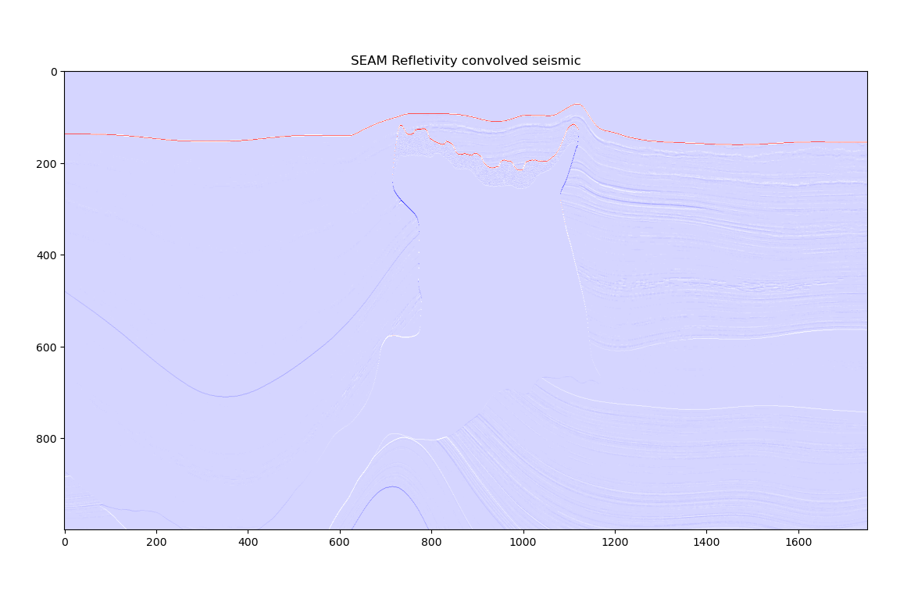

Slide 16
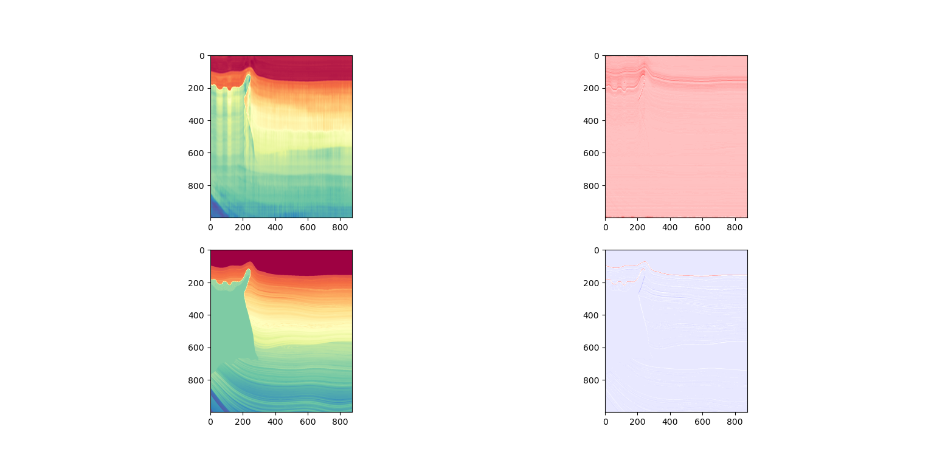
Adversarial training w/ variable autoencoding, 100 epochs on marmousi

Slide 17
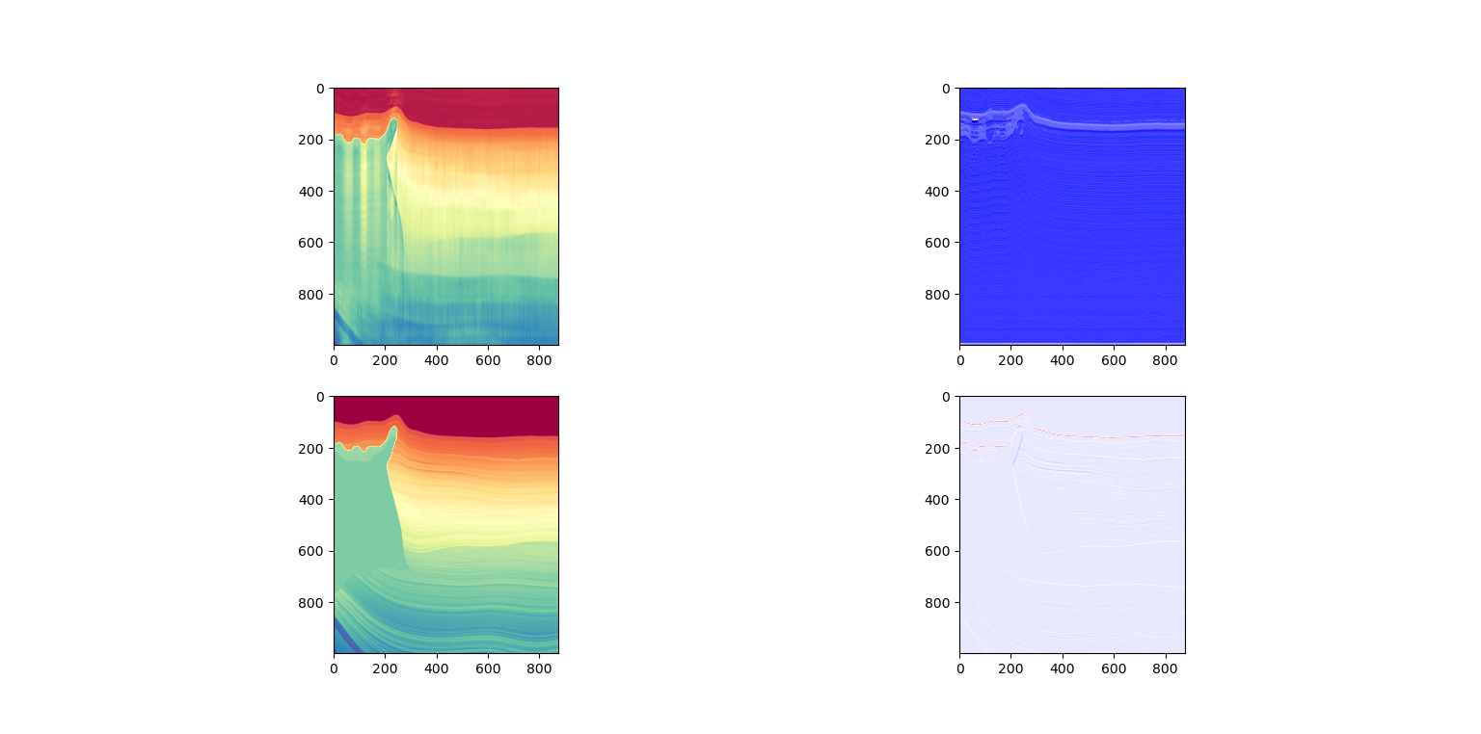
Same model configs, but 500 epochs

Slide 18
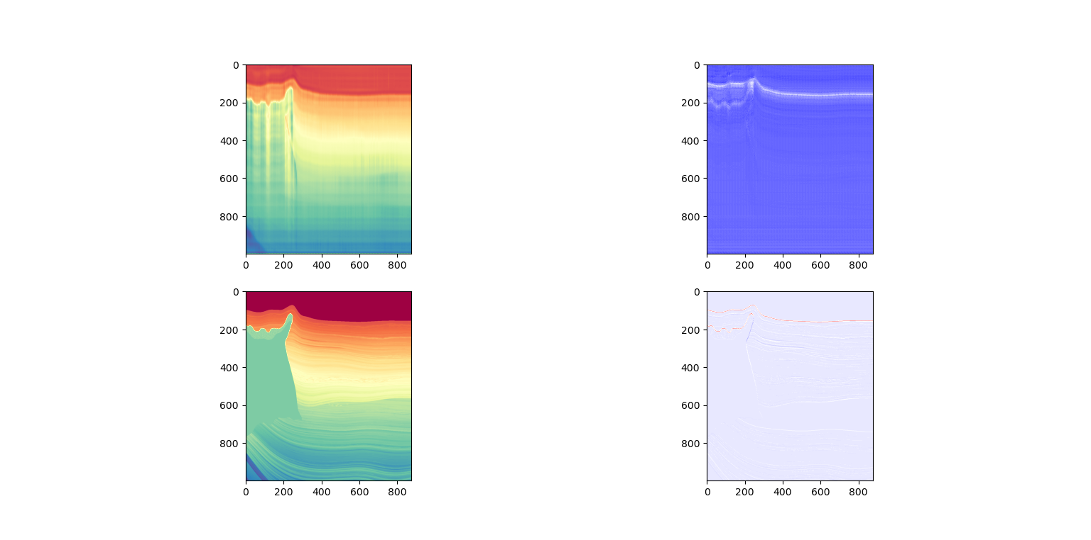
Adversarial training with variable autoencoding in 2D model
Grouping traces by 5

Slide 19
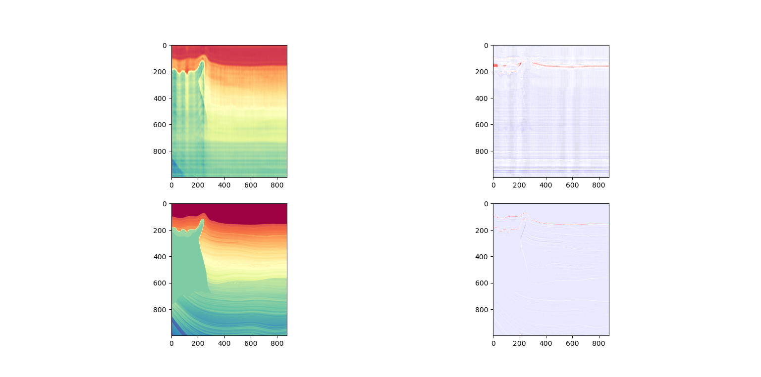
Adv, Var @ 100 epochs grouping traces by 7 with kernel size = (7, 9)

Slide 20
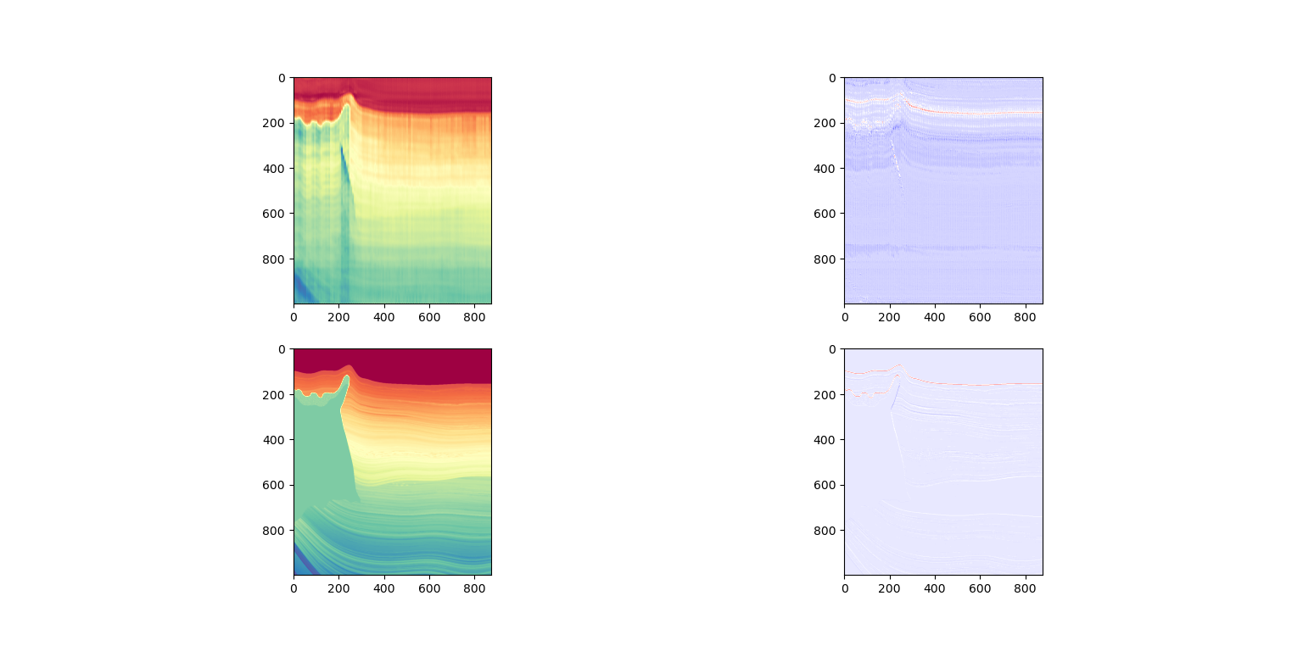
Same configs as previous, but with kernel size = (3, 9)

Slide 21
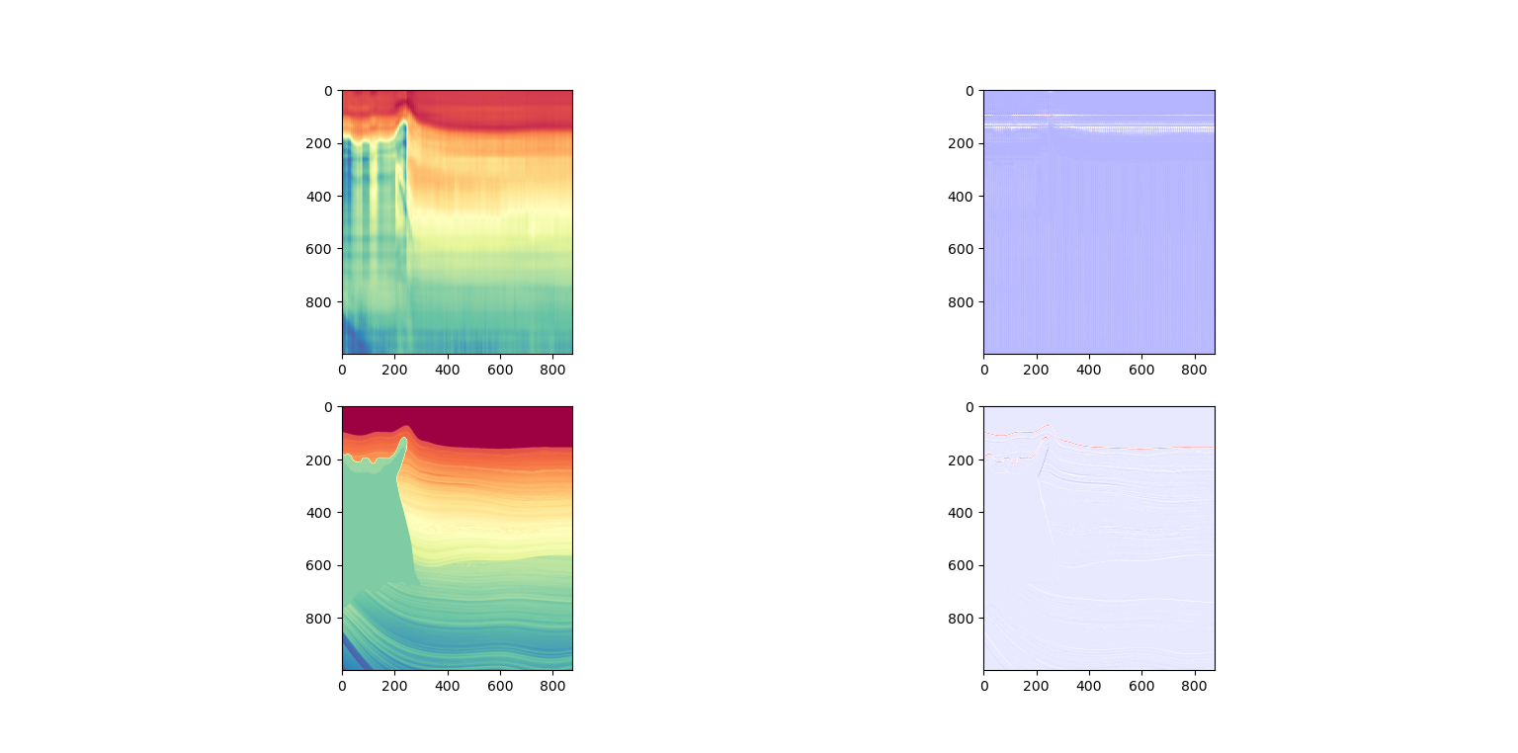
Same configs as previous, but with filters = 16 [increased]

Slide 22
Synthetic vs Real data
There is no issue with using multi-task learning on the synthetic data. It always gives valid results for both seismic reconstruction and for AI-regression.
Synthetic data is noiseless, and I have not yet examined the effect of adding noise
The modeling of the seismic is not very good, and convolution is done on reflectivity in depth domain. I have not yet tested the convolution on time domain data.
Zero padding on the sides of the traces may not be very good for the prediction
Images are really long and thin, lots of impact of the padding values

Slide 23
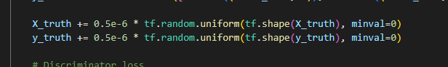
Noise to the data gets added through Variable encoding

Slide 24
Various models
 | Synthetic dataset [SEAM] |  | Real dataset [TNW]
Adversarial Training | Variable Autoencoding |  | Variable Autoencoding
 | Yes | No | Yes | No
2D | Yes | No | Yes | No

Slide 25
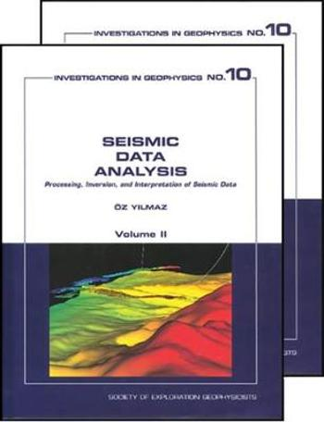
writing
For ML I’m using Tom Mitchell’s book «Machine Learning»
Also other sources from papers.
I need good sources

Slide 26
Road forward
Goals for this month:
Writing theory and method chapters in the thesis
Getting good tools for modeling the seismic, and switching to time domain.
Sorting out issues in the TNW dataset
I will be needing help with:
The geophysics [Meeting next week?]
The dataset
JR said he was going to talk with Mark
How to better align the AI with the seismic?

